Slide 1
CSCI -112 Introduction to computer Systems
LAB
Instructor: Santanu Banerjee

Slide 2
Floating point Exercise

Slide 3
Exercise 14
Section A
Complete the following exercises from your textbook (check the listing file to find the floating point representation.
Exercise 9.1:
1, 3, 9, 13, 20, 24
Exercise 9.2:
1. (b), (f), (j), (q), (w)
2. (a), (e)
No code submission is required, show your code to your instructor. (5 pts)
Section B
Attempt to write a function to convert ascii to floating point number. Use the windows32 framework. A sample solution is provided. Compare and correct your attempt as necessary.
; AcsiiToFloat(char str[])
; Description: Coverts the string to a floating point number
; Parameter: NULL terminated string
; Return Value: the floating point number to be stored in ST(i.e. st(0))
Submit your code to your instructor by 5/9/17 midnight. (5 points for legitimate attempt).

Slide 4
.586
.MODEL FLAT
INCLUDE io.h ; header file for input/output
.STACK 4096
.DATA
promptInput BYTE "Enter a string to trim", 0
strInput BYTE 80 DUP (?)
strResult BYTE80 DUP (?)
resultLbl BYTE "After trim:", 0
num DWORD ?
decbase DWORD10
fp4Res REAL4 ?
signflg DWORD 1

Slide 5
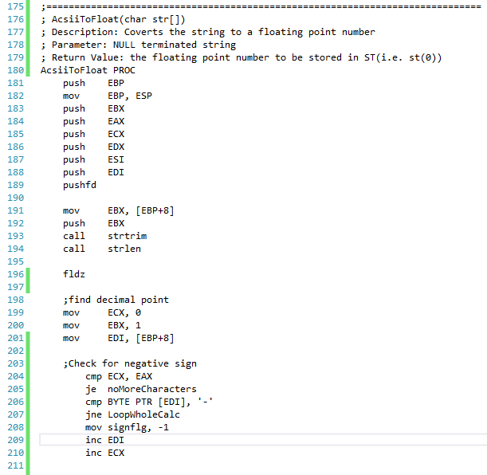
.CODE

Slide 6
